Slide 1
HUS Diagnostic Center
High-quality and effective diagnostics

Slide 2
HUS Diagnostic Center in numbers (2023)
3,400 EMPLOYEES
OPERATING REVENUE
EUR 438 MILL.
25.0 MILL.
laboratory tests
150 Units
1.1 MILL
Medical imaging examinations
12 24/7 hospital laboratories

Slide 3
DIAGNOSTIC CENTER IS ONE OF THE SIX PROFIT AREAS IN HUS
HUS Diagnostic Center provides medical imaging and laboratory services.
We aim to increase synergy between diagnostic specialties.
Forming cooperation networks nationally and within the specific catchment area.
Diagnostics as the basis of treatment paths.

Slide 4
HUS Diagnostic Center produces health

Slide 5
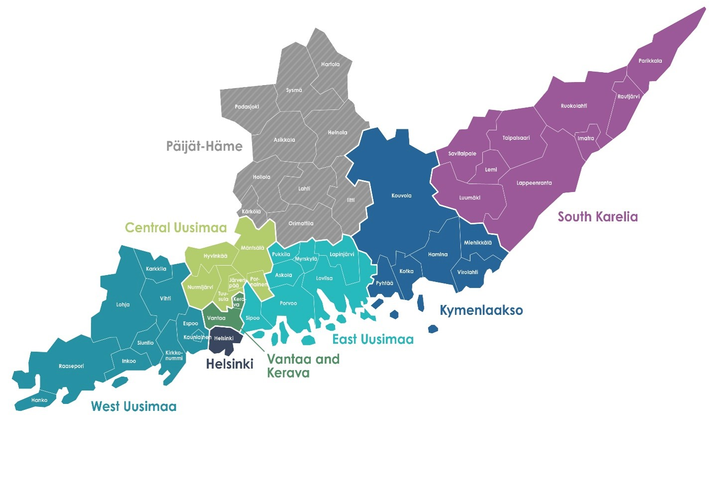
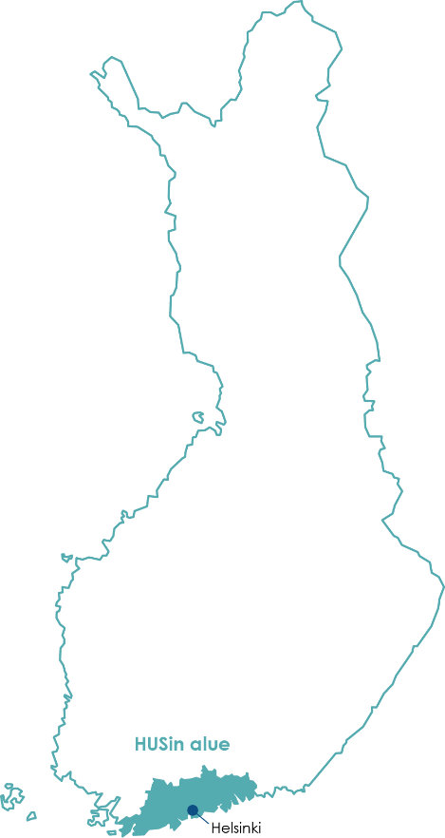
OPERATING AREA SPANS FROM HANKO TO PARIKKALA
Around 150 locations We mainly operate in HUS’s specialized healthcare and in primary healthcare in the wellbeing services counties in the HUS region.
We also provide laboratory and imaging services in the wellbeing service counties of Kymenlaakso and South Karelia.
Medical imaging services for Päijät-Häme Joint Authority for Social and Health Care (PHHKY) (Helsinki University Hospital's specific catchment area).

Slide 6
Our operations include
Radiology
Pathology
Preanalytics (sample collection)
Genetics
Clinical Pharmacology
Clinical Physiology and Nuclear Medicine
Clinical Neurophysiology
Clinical Chemistry
Clinical Microbiology

Slide 7
We research and educate
We work in eight specialties of laboratory medicine and imaging.
We have nationwide responsibility for examinations that require special expertise. We provide research and education required from a university hospital.
We engage in innovative research and product development.
Diagnostic examinations play a key role in the confirmation and exclusion of illnesses, as part of treatment and treatment monitoring, and screening.

Slide 8
LEADING EXPERTS - AN EXCELLENT WORKPLACE

Slide 9
Over 3,400 employees (2023)
2,450 nursing staff
445 doctors
270 other staff
260 specialists
Our staff includes, for example, laboratory technicians, radiographers, doctors, physicists, hospital chemists, hospital geneticists, and hospital microbiologists.

Slide 10
High-quality work
Our quality management system and management system meet certification standards.
We are customer-oriented and work systematically to improve our quality.
Continuous improvement is monitored annually.
Excluding radiology, the Diagnostic Center is a testing laboratory accredited by FINAS Finnish Accreditation Service; accreditation requirements SFS-EN ISO 15189:2013; accreditation code T055. Information on the accredited scopes and the included fields and units is available at www.finas.fi.
Medical imaging has been granted the ISO 9001:2015 Quality Certificate in 2018.

Slide 11
Efficient treatment pathways

Slide 12
Services production (2022)
Chemistry: 18 956 000
Sample collection: 3 403 000
Microbiology: 1 799 000
Radiology: 1 121 000
Clinical Physiology and Nuclear Medicine: 613 000
Pathology: 429 000
Blood products: 80 000
Genetics: 50 000
Clinical Neurophysiology: 29 000
Clinical Genetics, appointments: 6 000

Slide 13
Part of the treatment chain
Our customers include:
Patients and their attending physicians in HUS’s specialised healthcare and in primary healthcare in the HUS region’s wellbeing services counties.
We also provide laboratory and imaging services in the wellbeing services counties of Kymenlaakso and South Karelia.

Slide 14
Thank you!

