Slide 1
HUS Diagnostic Center
High-quality and effective diagnostics

Slide 2
HUS Diagnostic Center in numbers (2024)
3,300 EMPLOYEES
OPERATING REVENUE
EUR 462 MILL.
25.1 MILL.
laboratory tests
150 Units
1.2 MILL
Medical imaging examinations
10 24/7 hospital laboratories

Slide 3
DIAGNOSTIC CENTER IS ONE OF THE SIX PROFIT AREAS IN HUS
HUS Diagnostic Center provides medical imaging and laboratory services.
We aim to increase synergy between diagnostic specialties.
Forming cooperation networks nationally and within the specific catchment area.
Diagnostics as the basis of treatment paths.

Slide 4
HUS Diagnostic Center produces health

Slide 5
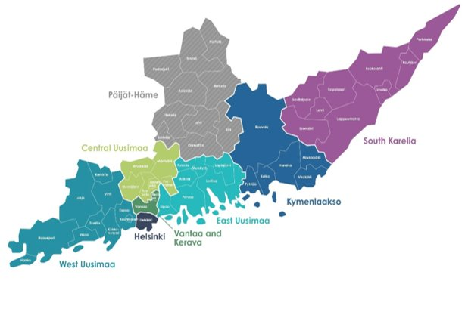
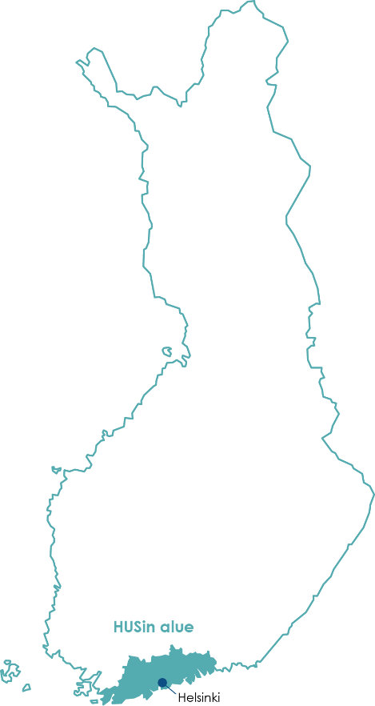
OPERATING AREA SPANS FROM HANKO TO PARIKKALA
Around 150 locations. We mainly operate in HUS’s specialized healthcare and in primary healthcare in the wellbeing services counties in the HUS region.
We also provide laboratory and imaging services in the wellbeing service counties of Kymenlaakso and South Karelia.
Medical imaging services for Päijät-Häme Joint Authority for Social and Health Care (PHHKY) (Helsinki University Hospital's specific catchment area).

Slide 6
Our operations include
Radiology
Pathology
Preanalytics (sample collection)
Genetics
Clinical Pharmacology
Clinical Physiology and Nuclear Medicine
Clinical Neurophysiology
Clinical Chemistry
Clinical Microbiology

Slide 7
We research and educate
We work in eight specialties of laboratory medicine and imaging.
We have nationwide responsibility for examinations that require special expertise. We provide research and education required from a university hospital.
We engage in innovative research and product development.
Diagnostic examinations play a key role in the confirmation and exclusion of illnesses, as part of treatment and treatment monitoring, and screening.

Slide 8
LEADING EXPERTS - AN EXCELLENT WORKPLACE

Slide 9
Over 3,400 employees (2024)
2,349 nursing staff
455 doctors
245 other staff
255 specialists
Our staff includes, for example, laboratory technicians, radiographers, doctors, physicists, hospital chemists, hospital geneticists, and hospital microbiologists.

Slide 10
High-quality work
Our quality management system and management system meet certification standards.
We are customer-oriented and work systematically to improve our quality.
Continuous improvement is monitored annually.
HUS Diagnostic Center is a testing laboratory accredited by FINAS Finnish Accreditation Service; accreditation requirements SFS-EN ISO 15189:2022; accreditation code T055. Information on the accredited scopes and the included fields and units is available at www.finas.fi.
Medical imaging has been granted the ISO 9001:2015 Quality Certificate in 2018.

Slide 11
Efficient treatment pathways

Slide 12
Services production (2024)
Chemistry: 18 886 000
Sample collection: 3 481 000
Microbiology: 1 686 000
Radiology: 1 178 000
Clinical Physiology and Nuclear Medicine: 797 000
Pathology: 530 000
Blood products: 79 000
Genetics: 57 000
Clinical Neurophysiology: 29 000
Clinical Genetics, appointments: 8 100

Slide 13
Part of the treatment chain
Our customers include:
Patients and their attending physicians in HUS’s specialised healthcare and in primary healthcare in the HUS region’s wellbeing services counties.
We also provide laboratory and imaging services in the wellbeing services counties of Kymenlaakso and South Karelia.

Slide 14
Our clients recommend our services
NPS interpretation guide: 40+ is excellent, 20-39 good, 0-19 fair, below 0 is a poor result.
Patients
Clinicians
Decision-makers
Promoters emphasised the expertise of the Diagnostic Center, the quality of the examinations and reports, and the smoothness of cooperation.
How likely are you to recommend HUS Diagnostic Center’s services to your colleagues?
(Survey for clinician clients, on a scale of 0–10)
NPS +87
Positive feedback emphasized caring interaction, pleasant and professional staff, and the smooth service.
How likely are you to recommend the service you received to your friends or family if they were in a similar situation?
(Survey for patients, on a scale of 0–10)
Promoters appreciate the high quality and trustworthiness of the services, co-operation, and dialogue with HUS Diagnostic Center.
How likely are you to recommend HUS Diagnostic Center’s services to your colleagues?
(Survey for organizational clients on a scale of 0–10)

Slide 15
Thank you!

